Slide 1
Design of FMCW Radar Based on Software Defined Radio with GNURadio for Detection, Range Estimation, and Velocity of an Object
Bima Pancara Haryono Putra
1101210528

Slide 2
Outline
Introduction
Literature Review
System Model and Design

Slide 3
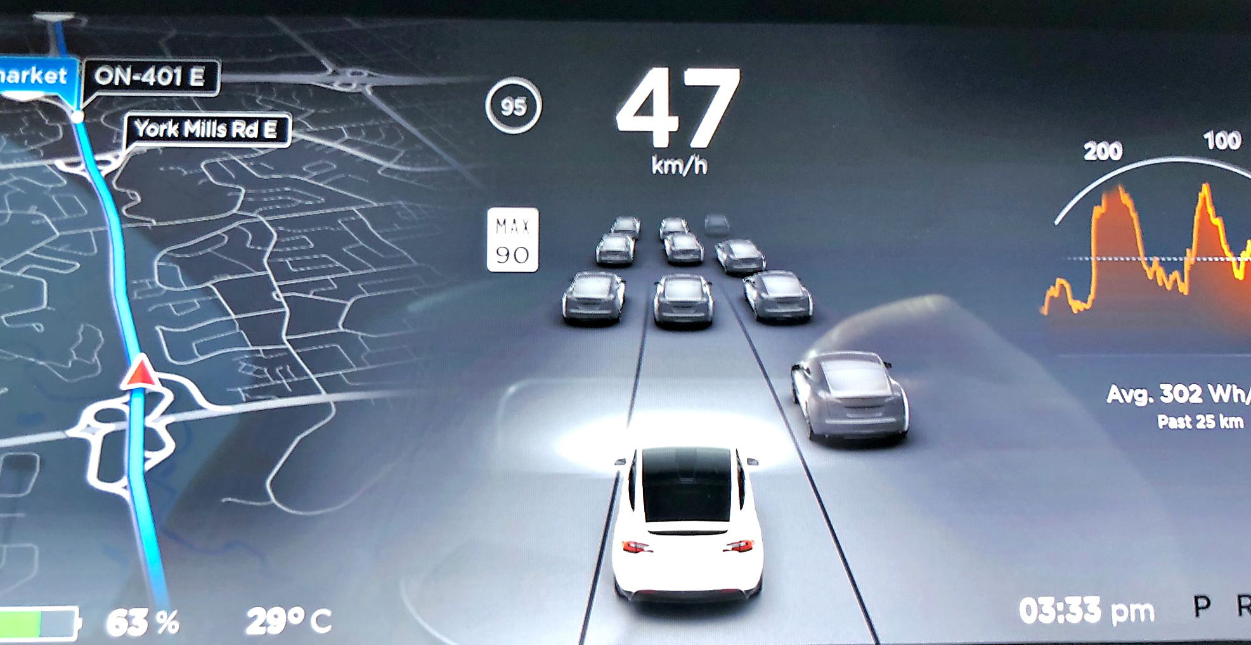

Sensing The World Through Sensor Technology

Slide 4
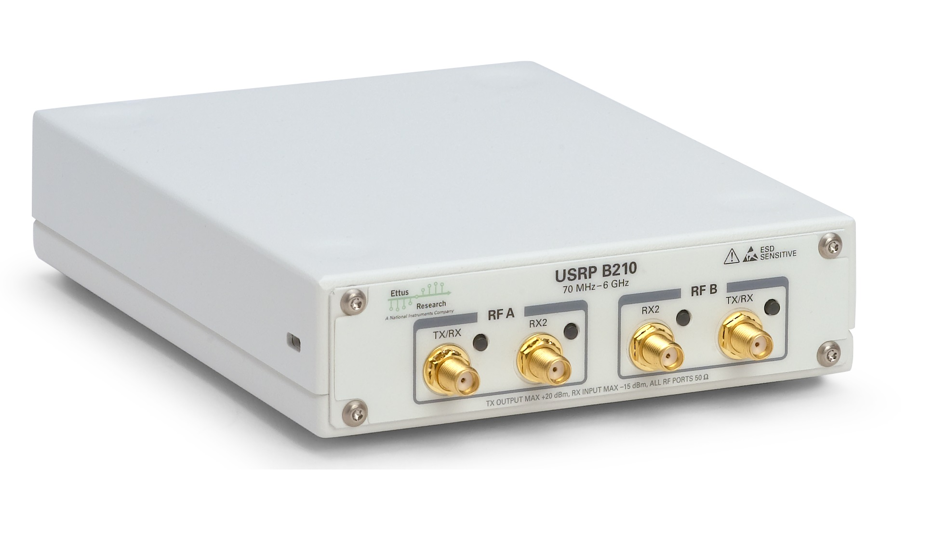



Slide 5
Primary Goals
To Design FMCW Radar system based on USRP B210 with GNURadio.
To assess the detection, range estimation, and velocity of an object from the designed system.
To know the accuracy of detection, range estimation, and velocity of an object from the designed system.

Slide 6
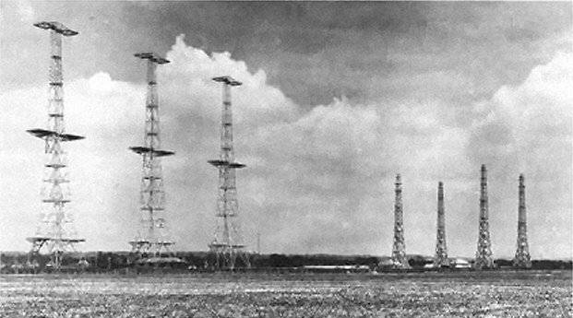
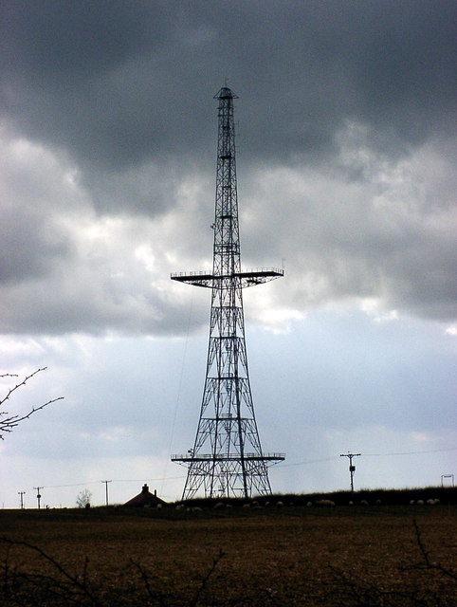
RAdio Detection And Ranging
Chain Home at RAF Poling, West Sussex

Slide 7
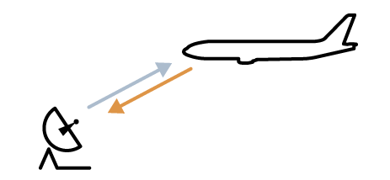
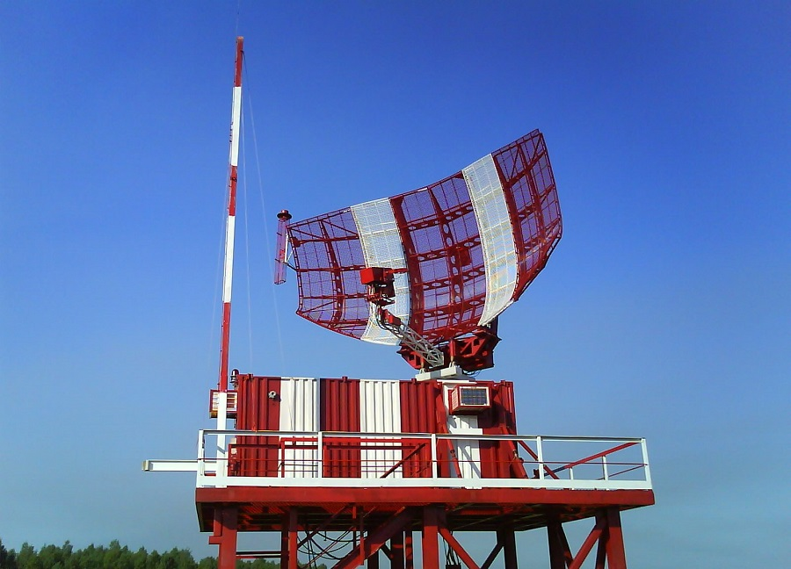
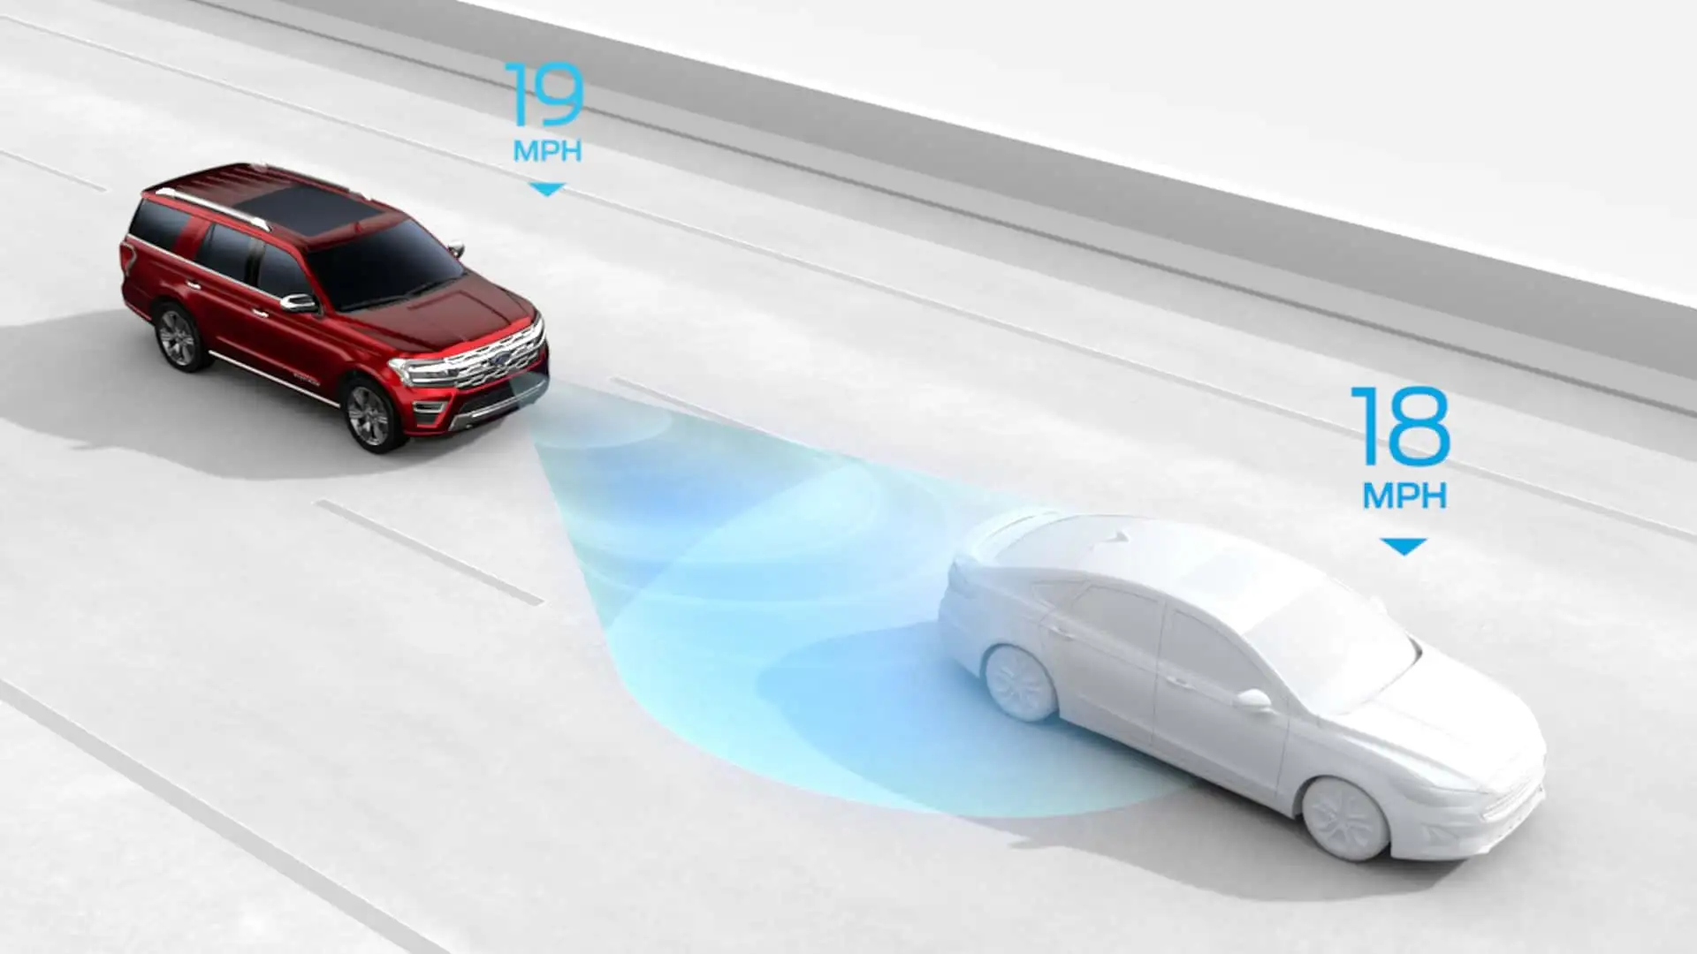


Slide 8
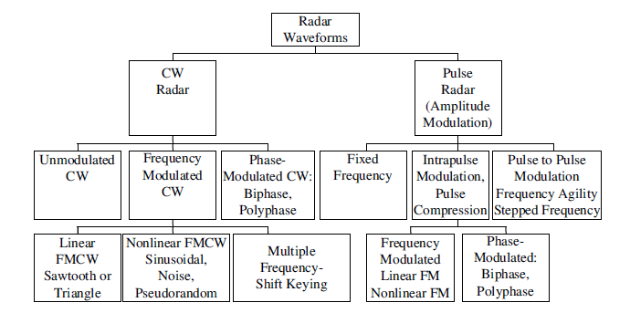

Slide 9
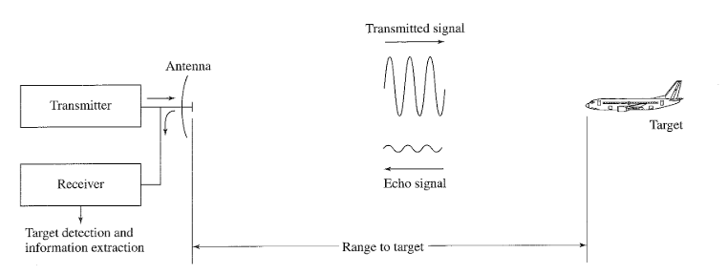
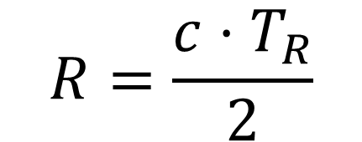
$$R=\frac{c⋅T_{R}}{2}$$

Slide 10
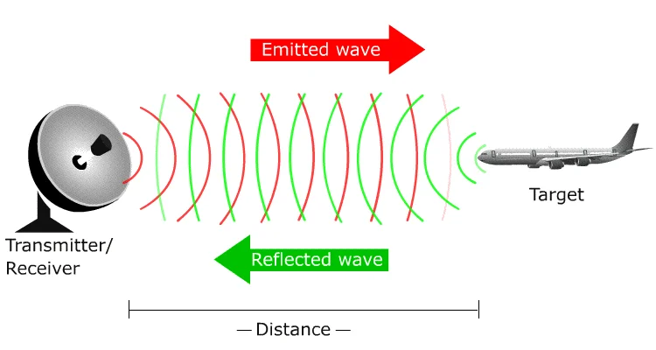

Slide 11
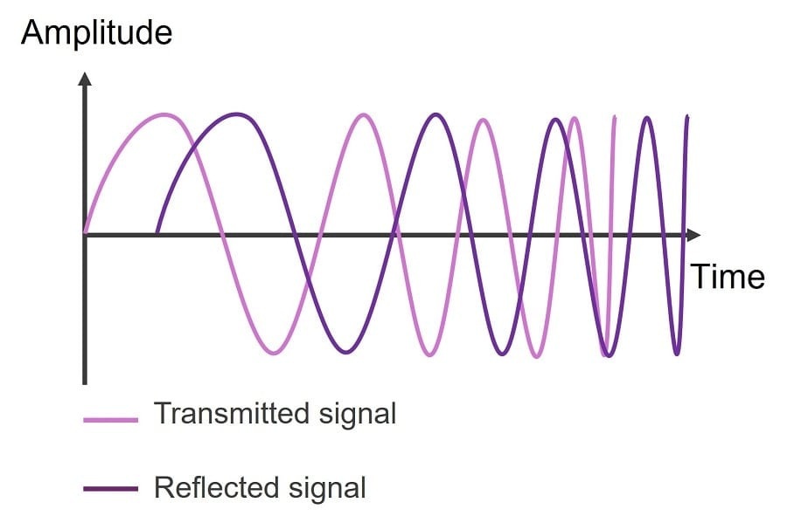

Slide 12
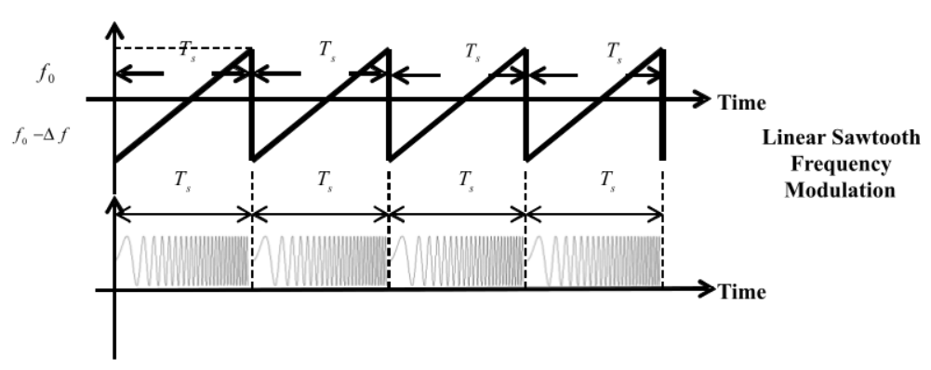
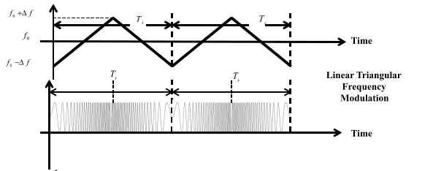

Slide 13
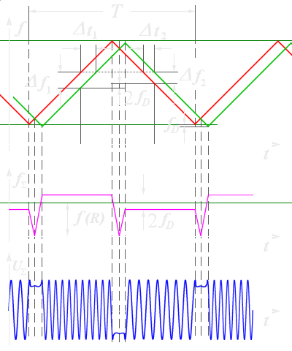

Slide 14
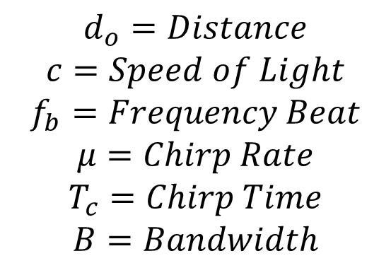
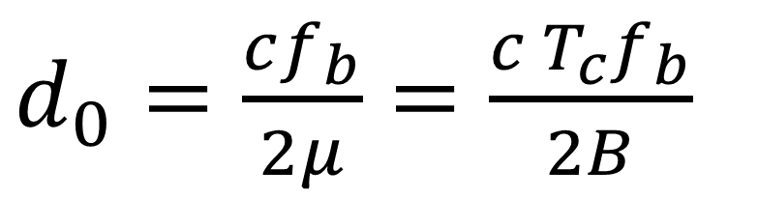
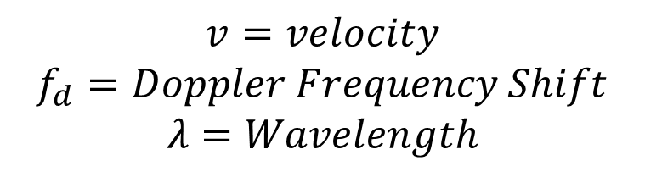
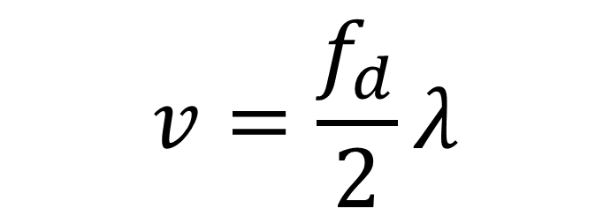
$d_{0}=\frac{cf_{b}}{2μ}=\frac{c T_{c}f_{b}}{2B}$
$$v=\frac{f_{d}}{2}λ$$
$$d_{o}=Distance$$
$$c=Speed of Light$$
$$f_{b}=Frequency Beat$$
$$μ=Chirp Rate$$
$$T_{c}=Chirp Time$$
$$B=Bandwidth$$
$$v=velocity$$
$$f_{d}=Doppler Frequency Shift$$
$$λ=Wavelength$$

Slide 15
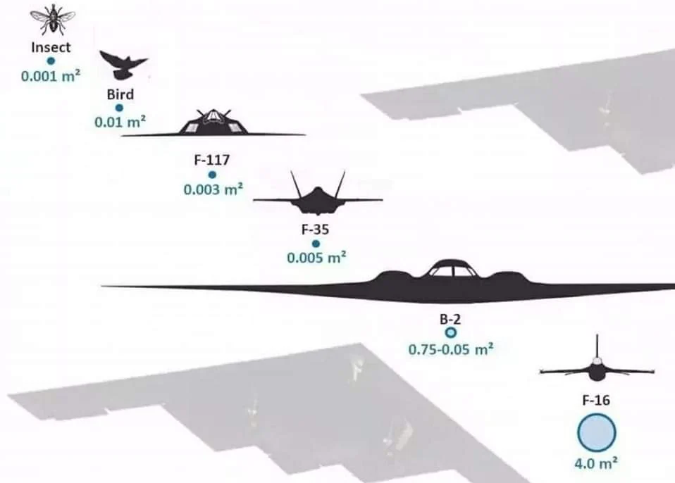
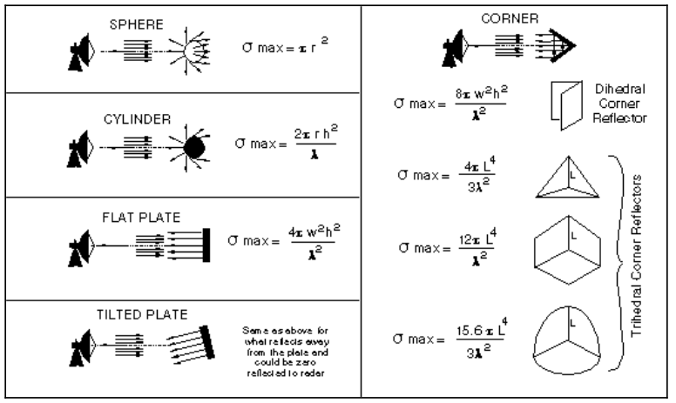
Radar Cross Section

Slide 16
Software Defined Radio

Slide 17
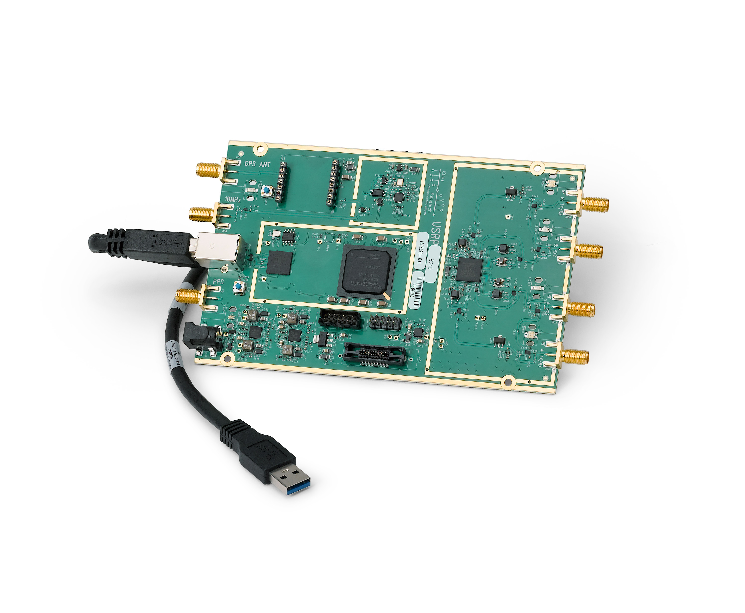
Universal Software Radio Peripheral

Slide 18
No. | Description | Value | Unit
1 | RF Coverage | 70 – 6 | MHz – GHz
2 | Analog to Digital Converter Sample Rate | 61,44 | MS/s
3 | Analog to Digital Resolution | 12 | bits
4 | Analog to Digital Wideband SFDR | 78 | dBc
5 | Digital to Analog Converter Sample Rate | 61,44 | MS/s
6 | Digital to Analog Resolution | 12 | bits
7 | Host Sample Rate (16b) | 61,44 | MS/s
8 | Frequency Accuracy | ± 2,0 | ppm
9 | W/ GPS Unlocked TCXO Reference | ± 75 | ppb
10 | W/ GPS Locked TCXO Reference | < 1 | ppb

Slide 19
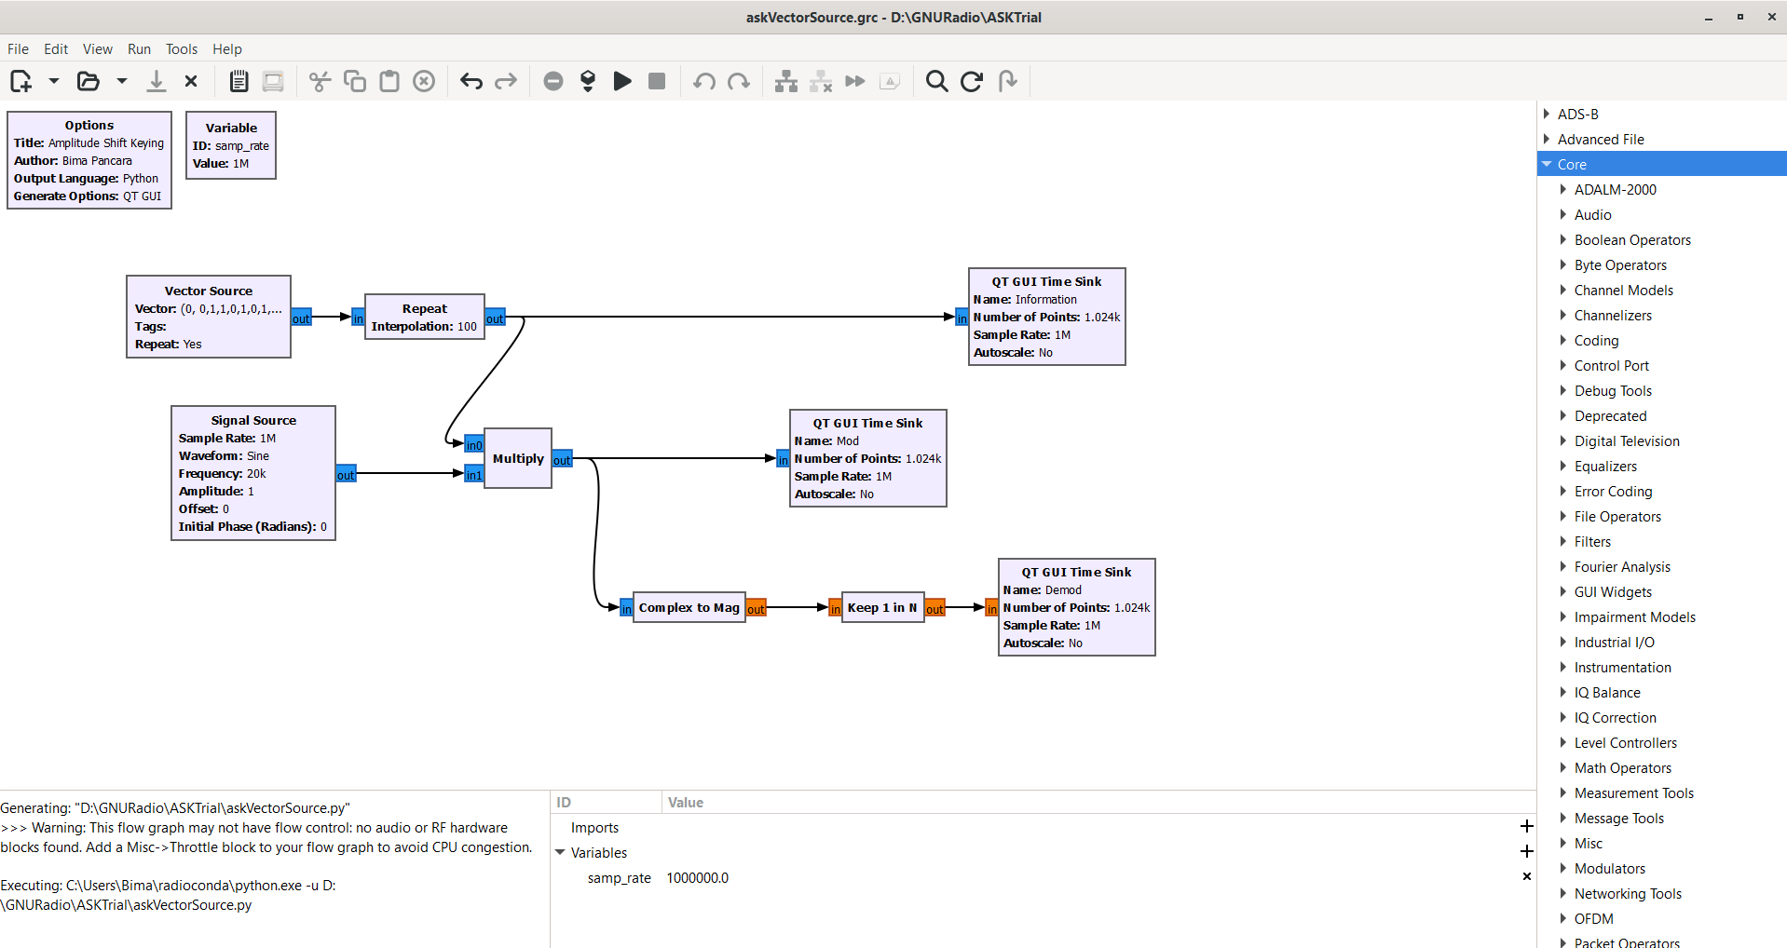
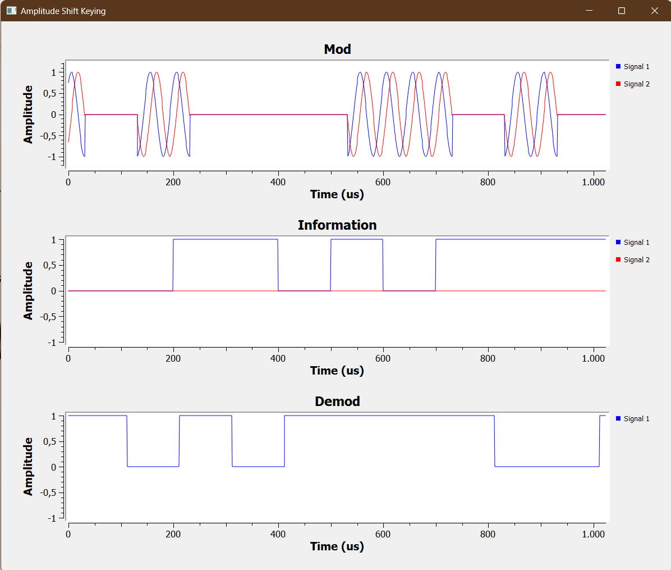

Slide 20
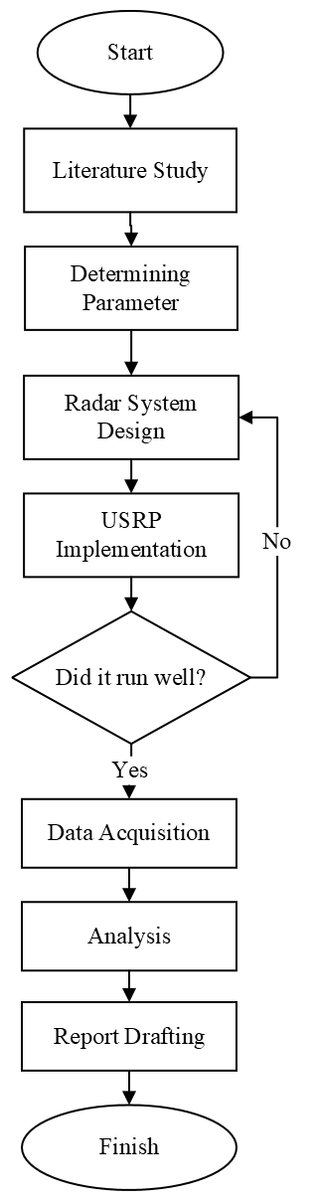

Slide 21
Research Parameter
Trial Parameter
Center Frequency | GHz
Bandwidth | MHz
Range | m
Velocity | m/s
RMSE | -

Slide 22
No. | Spesification | Description
1 | USRP | B210
2 | Center Frequency | 3 GHz
3 | Bandwidth | 50 MHz
4 | Modulation | Triangular
5 | Maximum Range | 150 m
6 | Range Resolution | 3 m
7 | Maximum Velocity | 15 m/s
8 | Velocity Resolution | 1 m/s
9 | Chirp Time | 0,001667 s
10 | Chirp Rate | 30000 MHz

Slide 23
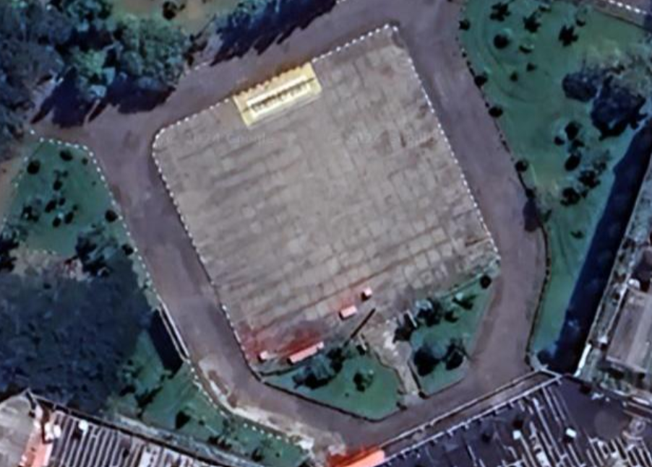
Experiment Site

Slide 24
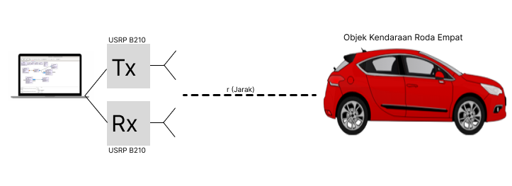
Experiment Scheme

Slide 25
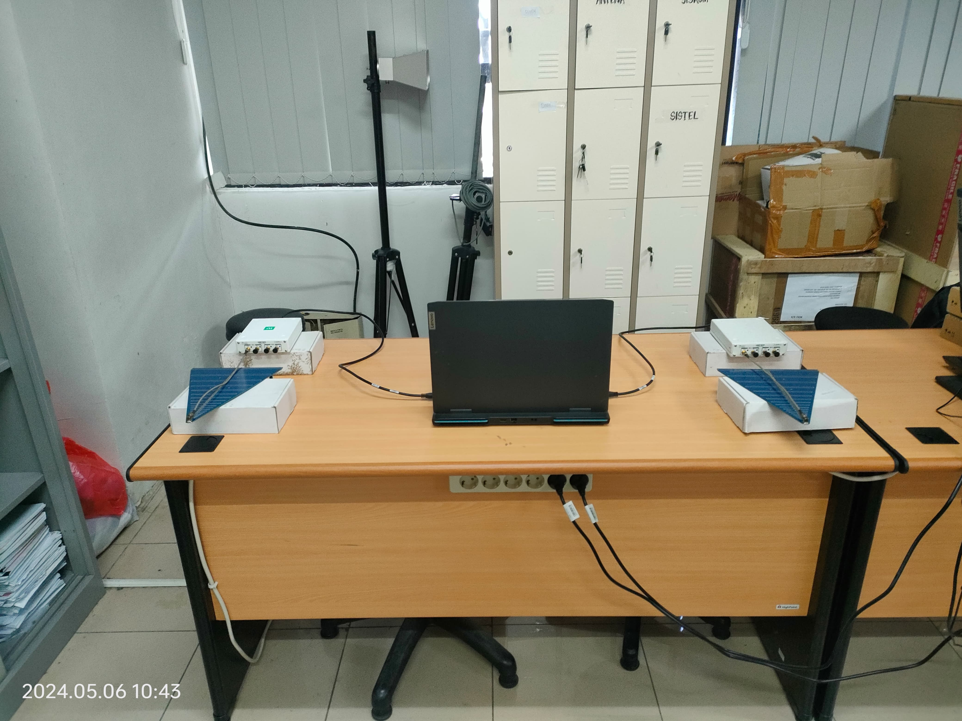
Experiment Configuration

Slide 26
Contribution
Test the accuracy of FMCW Radar design with GNURadio and implemented in B210 USRP to detect, range estimation, and velocity of an objet
As a reference on the implementation of FMCW Radar in many industry

